Slide 1
Chapter 4 Amino Acids with a look at hydrophobic interactions from Chapter 2

Slide 2
Outline
What are hydrophobic interactions?
What are the structures and properties of amino acids?
What are the stereochemical properties of amino acids?
What are the acid-base properties of amino acids?
What are the spectroscopic properties of amino acids?
How are amino acid mixtures separated and analyzed?
What reactions do amino acids undergo?

Slide 3
Hydrophobic Interactions
A nonpolar solute "organizes" water at its surface into an H-bonded clathrate-like structure
This is an increase in "order" of water
This is an unfavorable decrease in ENTROPY
Nonpolar molecules associate to reduce the nonpolar surface area and thus minimize the decrease in ENTROPY

Slide 4
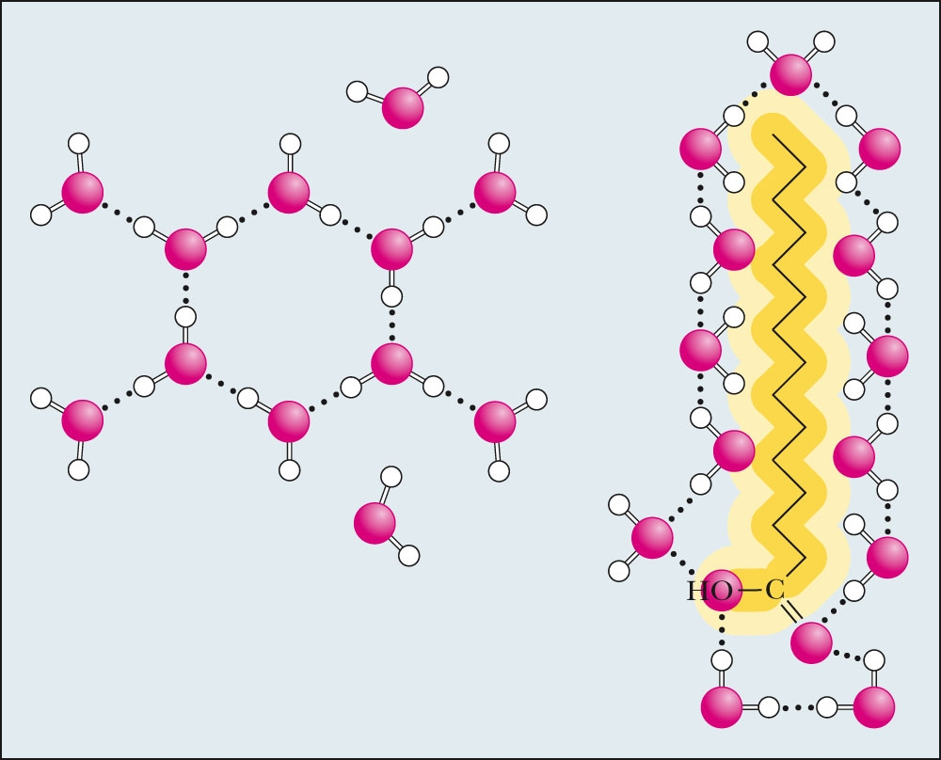
Figure 2.5
(left) A network of transiently H-bonded water molecules.
(right) A clathrate cage of more ordered, H-bonded water molecules around a nonpolar solute molecule.

Slide 5
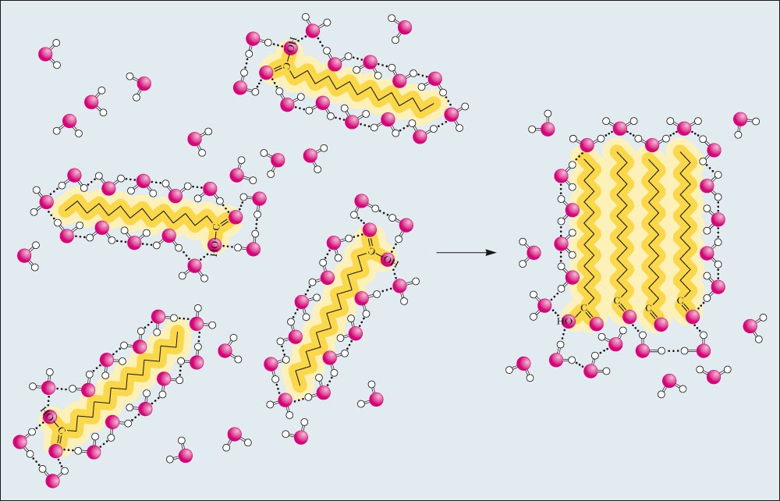
Hydrophobic Interactions
Fig. 2.6 Association of nonpolar molecules releases water from the clathrate structures, increasing the entropy of solvent water. This entropy-driven association of nonpolar solutes is called hydrophobic interaction.

Slide 6
Amphiphilic Molecules
Also called "amphipathic“
Refers to molecules that contain both polar and nonpolar groups
These molecules are attracted to both polar and nonpolar environments
Good examples - fatty acids and detergents, such as SDS (sodium dodecyl sulfate), and most common amino acids

Slide 7
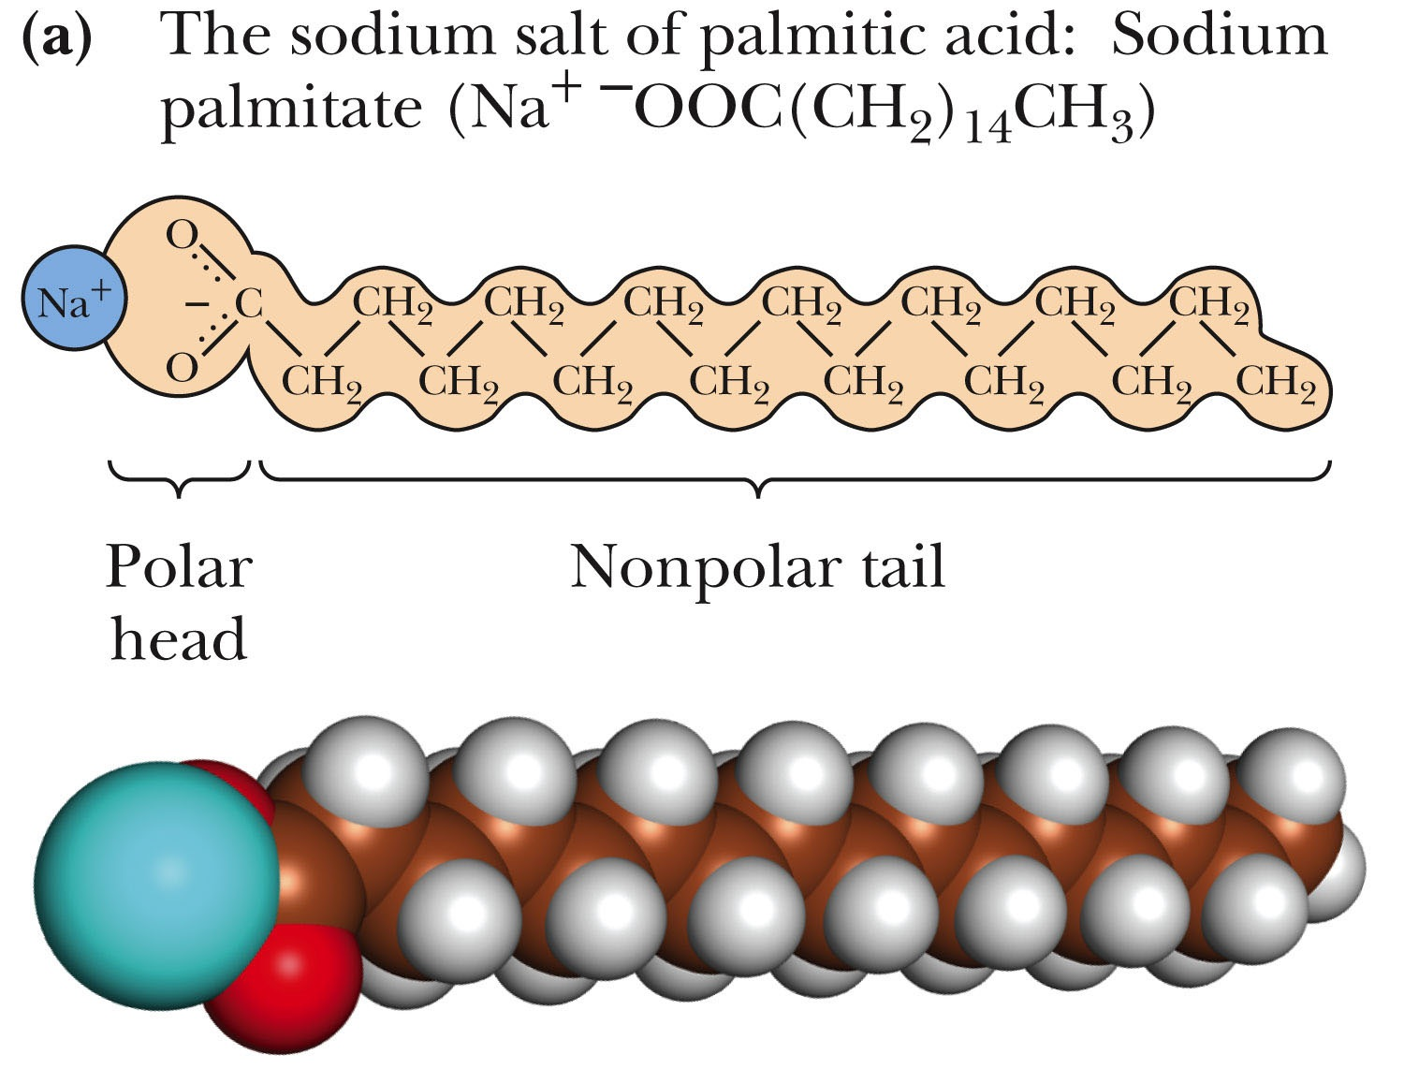
Amphiphilic Molecules
Figure 2.7 An amphiphilic molecule: sodium palmitate. Amphiphilic molecules are frequently symbolized by a ball and zig-zag line structure
,where the ball represents the hydrophilic polar head and the zig-zag represents the nonpolar hydrophobic hydrocarbon tail.

Slide 8
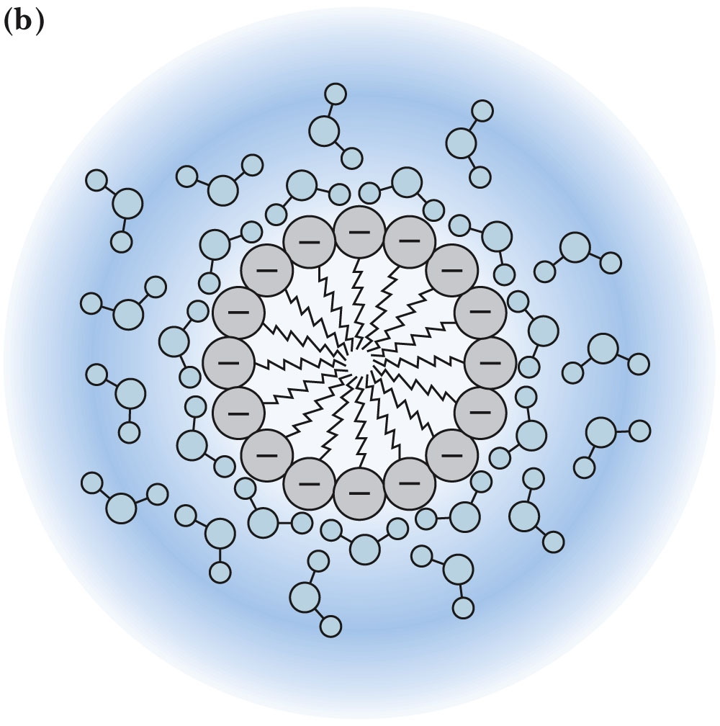
Section through a Micelle
Figure 2.7b Micelle formation by amphiphilic molecules in aqueous solution. Negatively charged carboxylate head groups orient to the micelle surface and interact with the polar H2O molecules via H bonding. The nonpolar hydrocarbon tails cluster in the interior of the spherical micelle, driven by hydrophobic exclusion from the solvent and the formation of favorable van der Waals interactions. Because of their negatively charged surfaces, neighboring micelles repel one another and thereby maintain a relative stability in solution.

Slide 9
What Are the Structures and Properties of Amino Acids?
Amino acids contain a central tetrahedral carbon atom, the α-carbon
Amino acids can polymerize via peptide bonds between the α-amino and α-carboxyl groups
There are 20 common (aka standard) amino acids found in proteins
Several amino acids occur only rarely in proteins
Some amino acids can be modified after incorporation in proteins (i. e., post-translational modification)
Some amino acids are not found in proteins

Slide 10
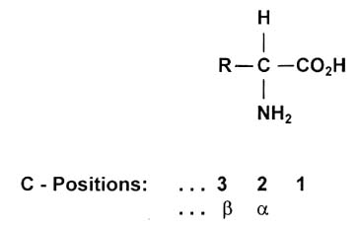
Amino Acid Structure
Molecular weight range for standard amino acids
75 - 204
Gly - Trp
Average molecular weight per residue in protein is ~110
(this excludes H₂0 lost in polymerization)

Slide 11

Amino acids are chiral molecules
“To hold, as ‘twere, the mirror up to nature.”
William Shakespeare, Hamlet
All objects have mirror images, and amino acids exist in mirror-image forms. Only the L-isomers of amino acids occur commonly in nature.
Three Sisters Wilderness, Oregon

Slide 12
Stereochemistry of Amino Acids
All but glycine are chiral due to an asymmetric α-carbon
L-amino acids predominate in nature and are the form incorporated by ribosomes into proteins
D,L-nomenclature is based on D- and L-glyceraldehyde
R,S-nomenclature system is superior, since amino acids like isoleucine and threonine (with two chiral centers) can be named unambiguously

Slide 13
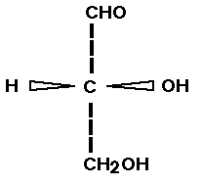
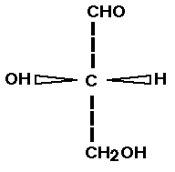
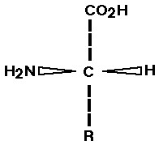
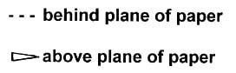
Distinguishing D from L amino acids
Note: D, L is not d, l ; D, L doesn't indicate rotation of plane polarized light.
L designation is assigned by structural analogy with L-glyceraldehyde
D - glyceraldehyde
L - glyceraldehyde
L - amino acid

Slide 14
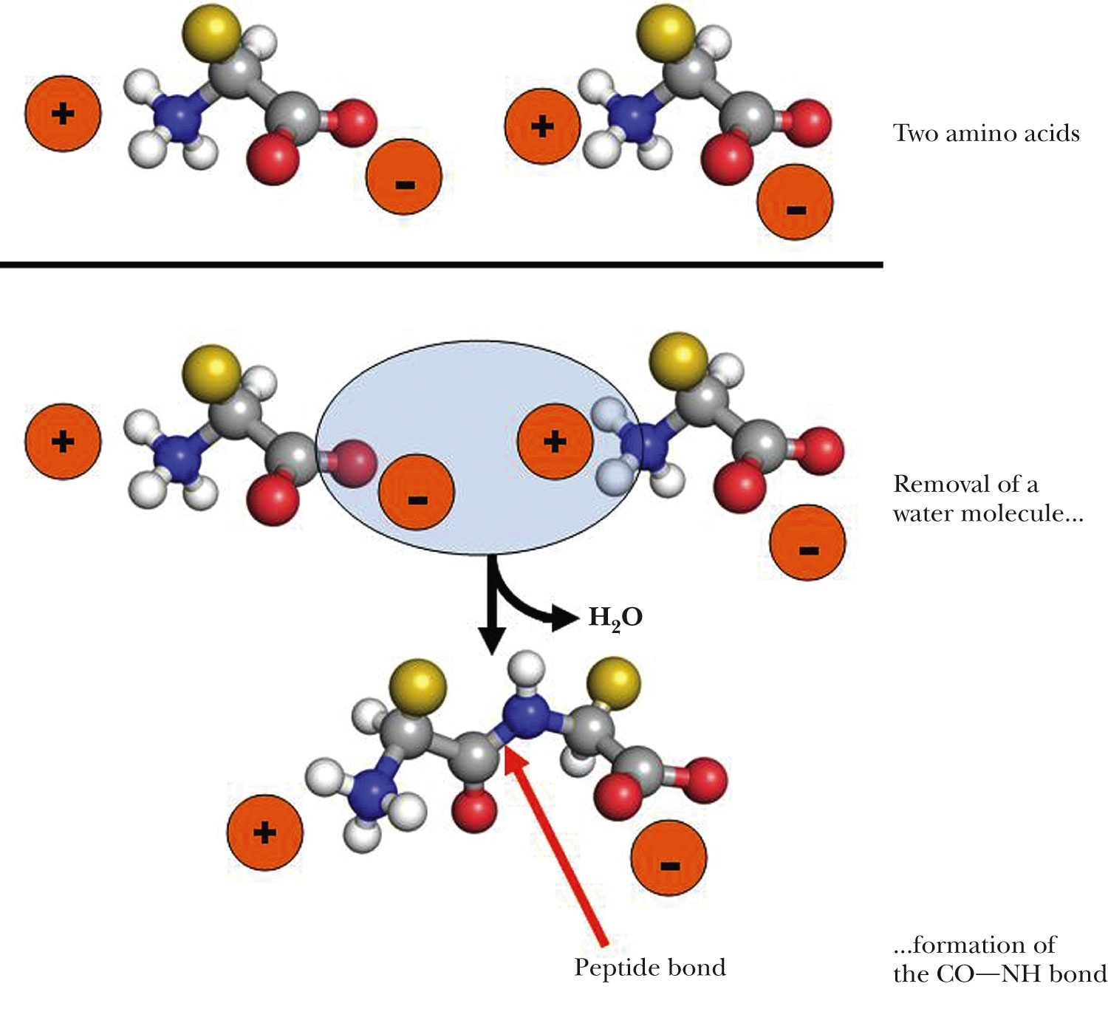
Amino Acids Can Join Via Peptide Bonds
Figure 4.2 Two amino acids can react with loss of a water molecule to form a covalent bond. The bond joining the two amino acids is called a peptide bond.

Slide 15
The 20 common amino acids
You should know:
Names
Structures (Be able to draw.)
Approximate pK_{a} values
3-letter and 1-letter abbreviations
Classifications based on physical properties, e.g., non-polar aliphatic amino acids, basic, etc. (Be careful in accepting G&G designation. They can be misleading.)

Slide 16
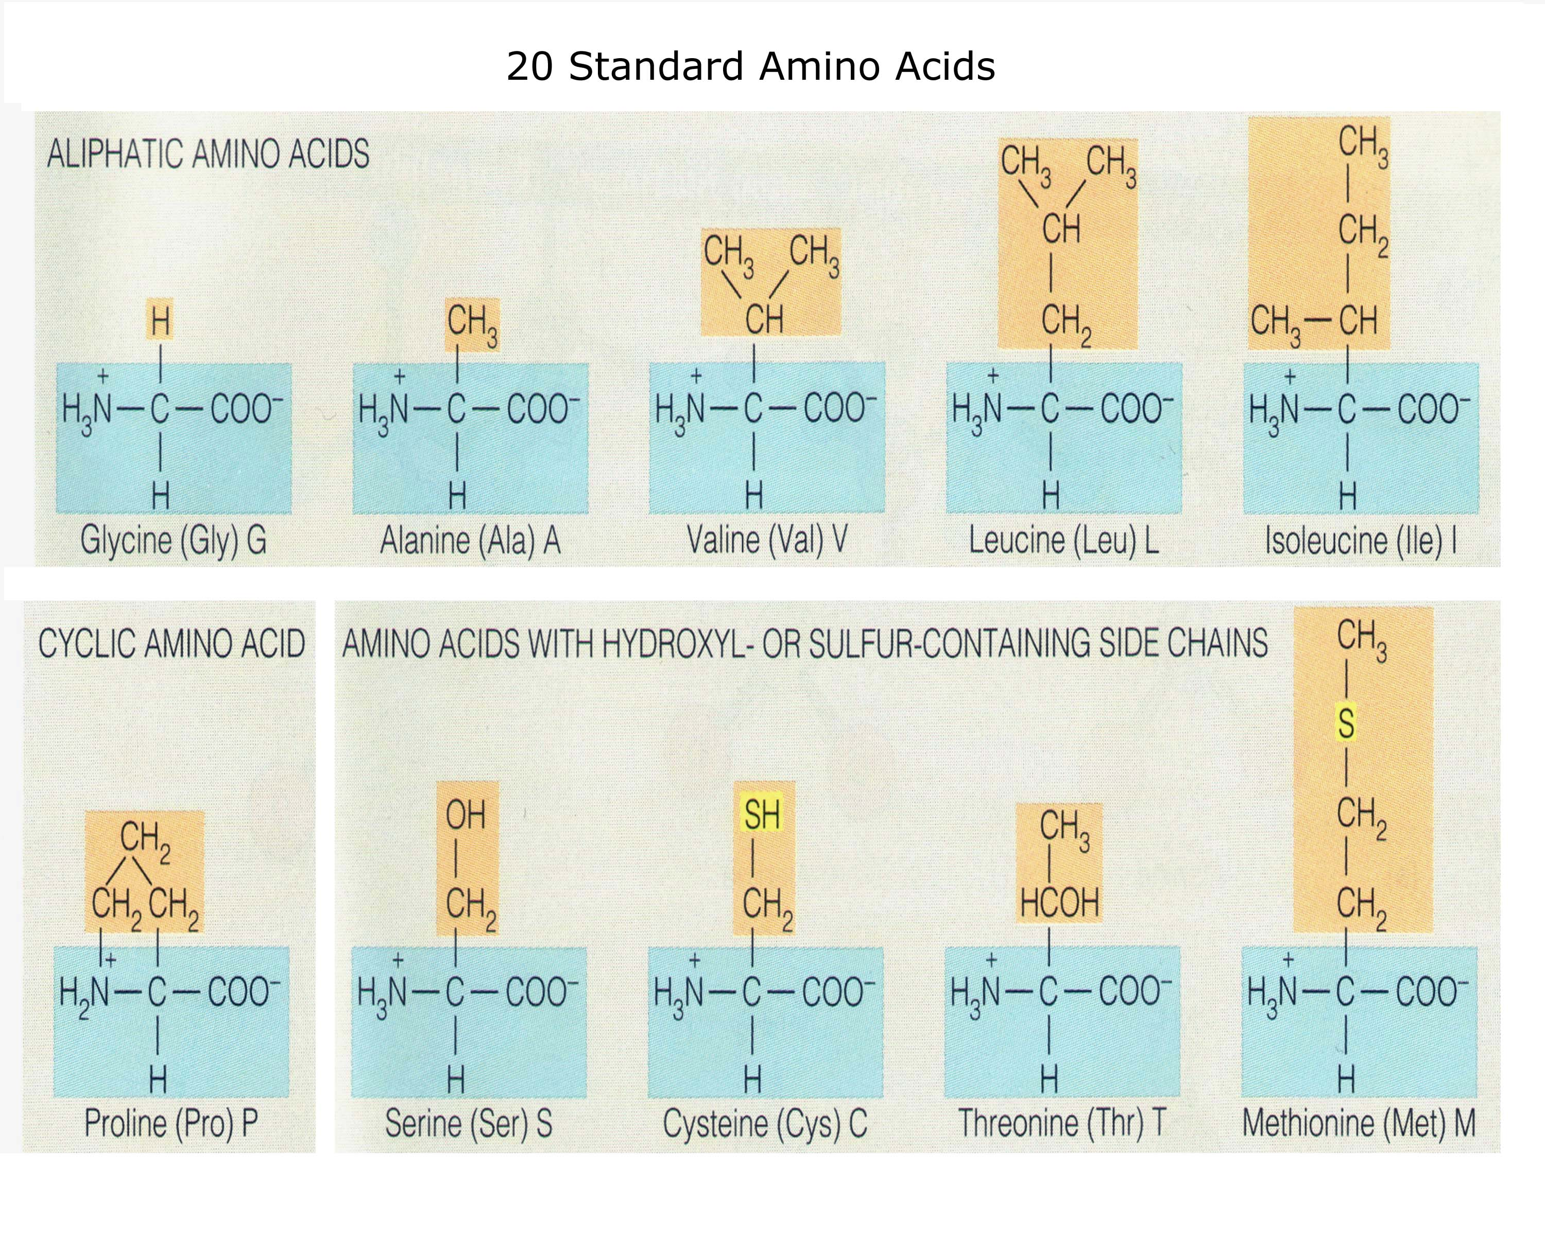

Slide 17
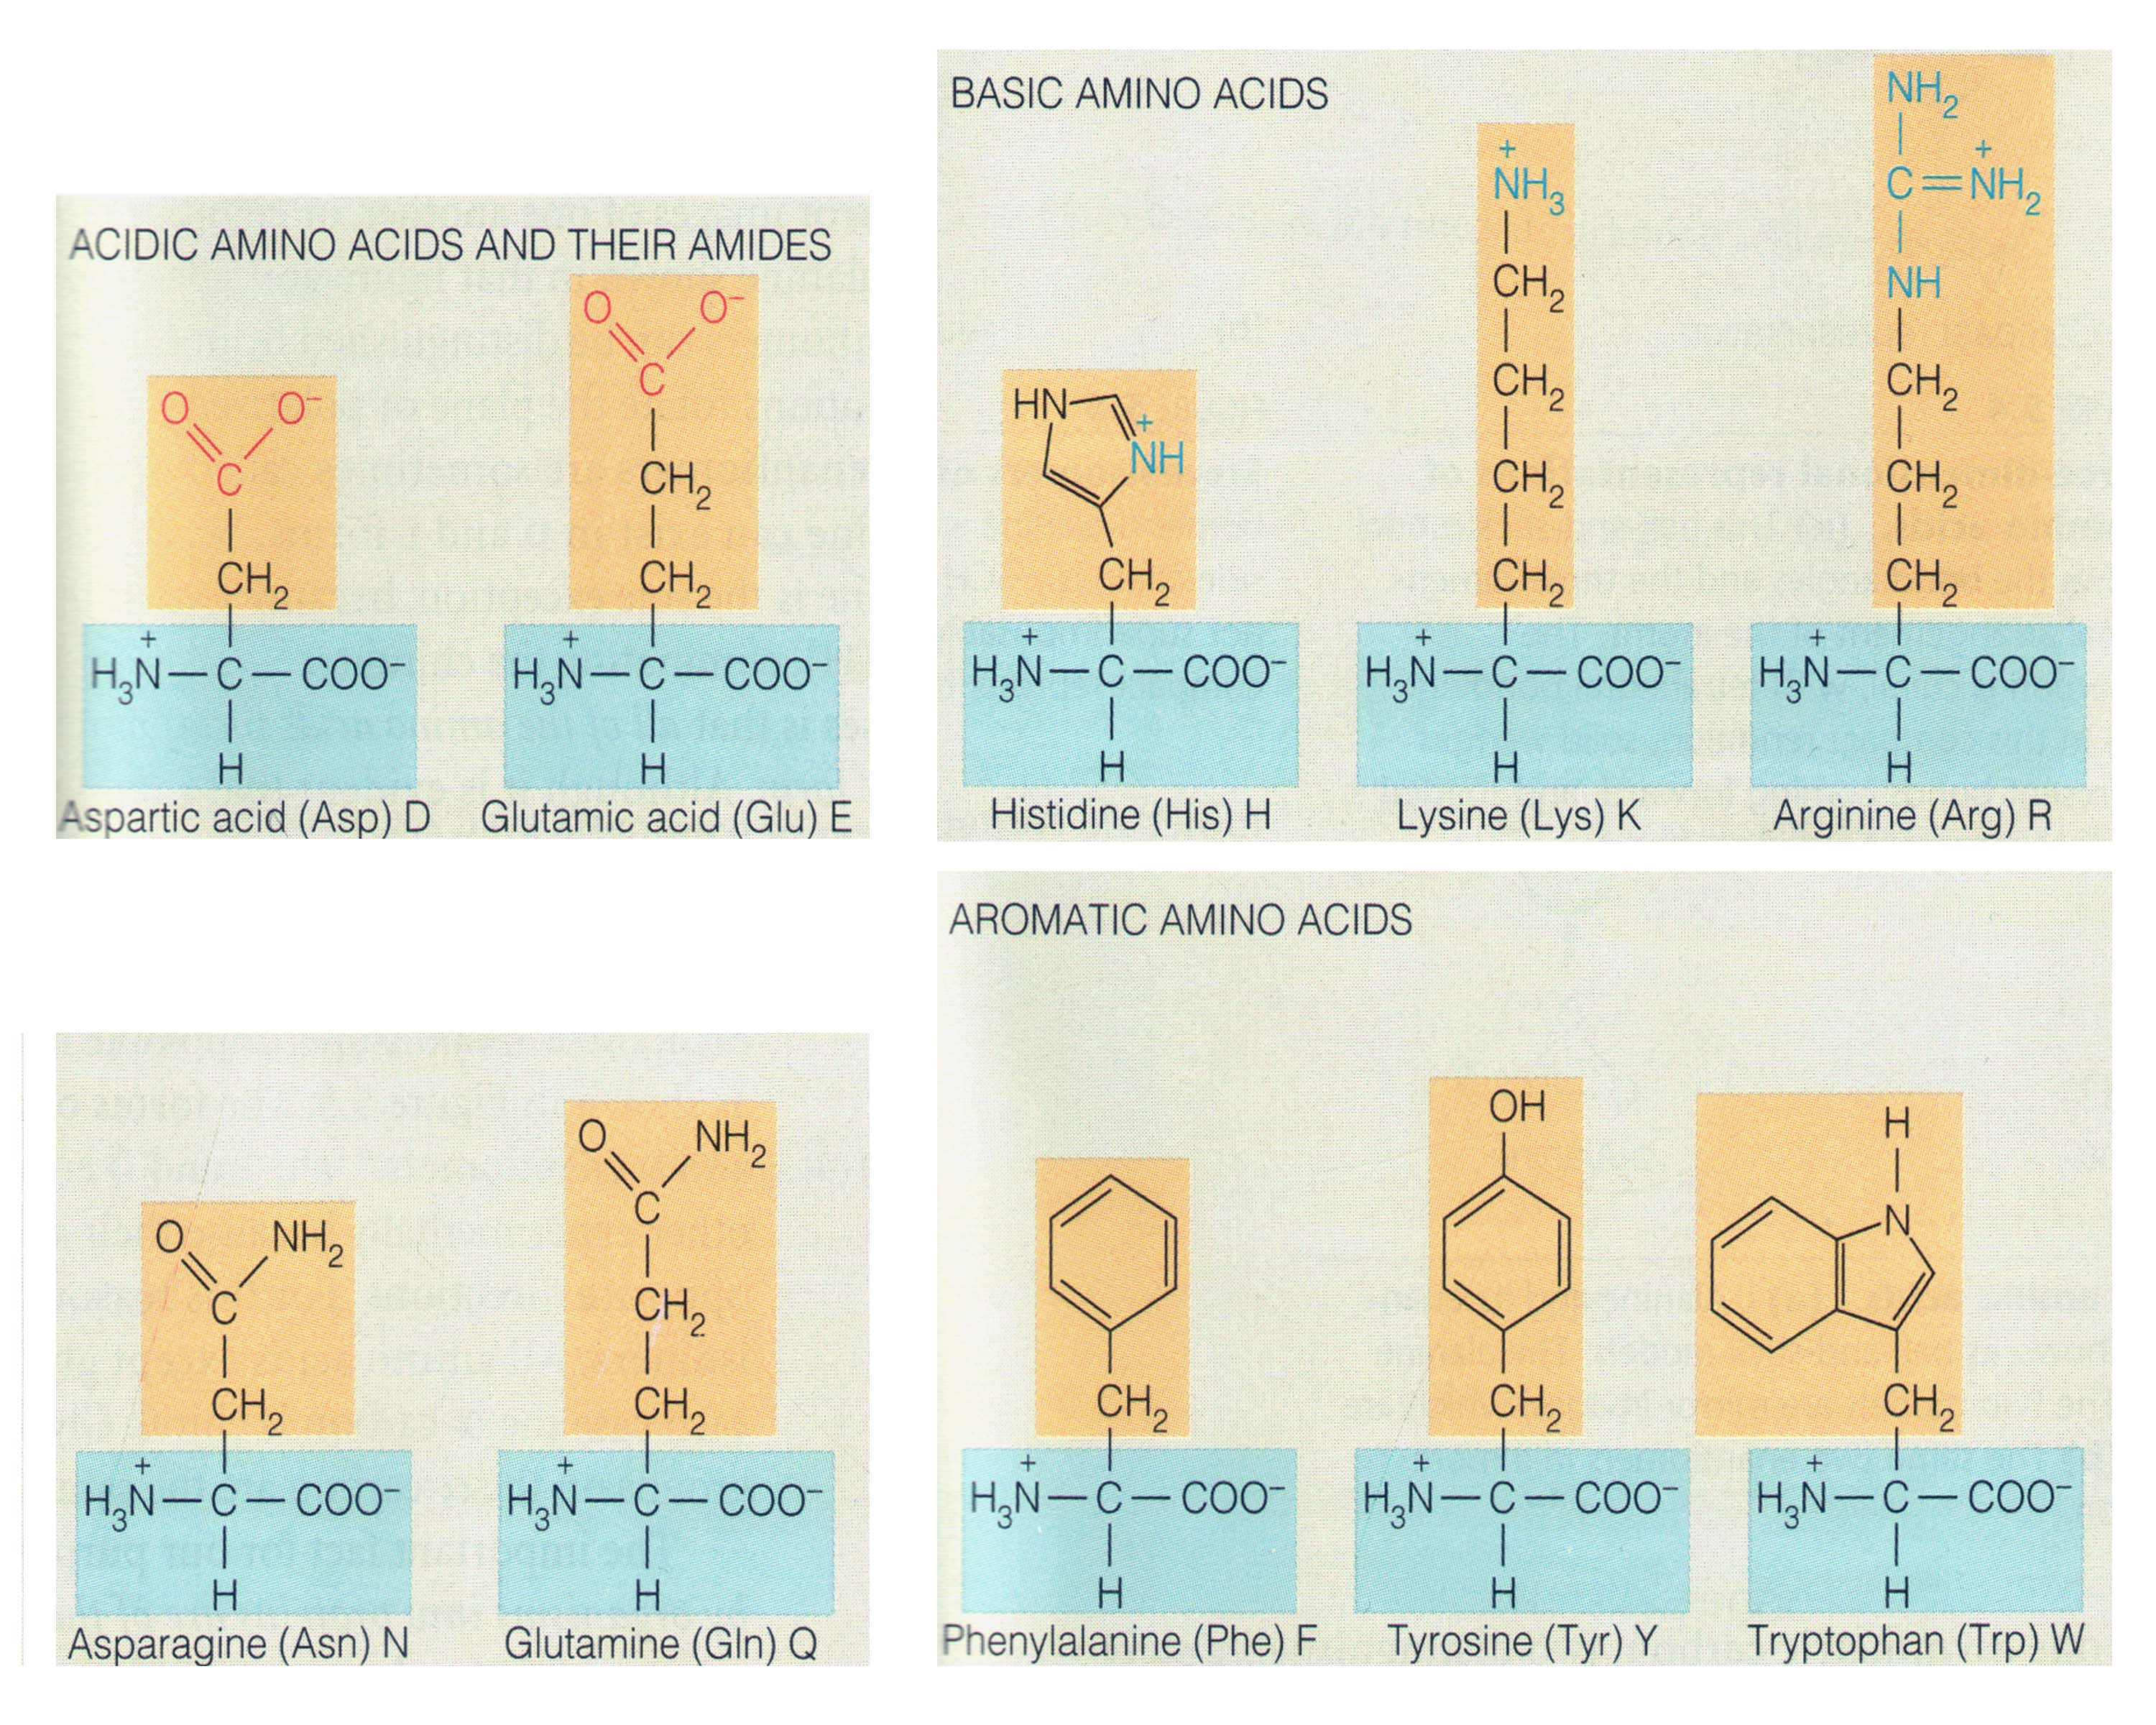

Slide 18
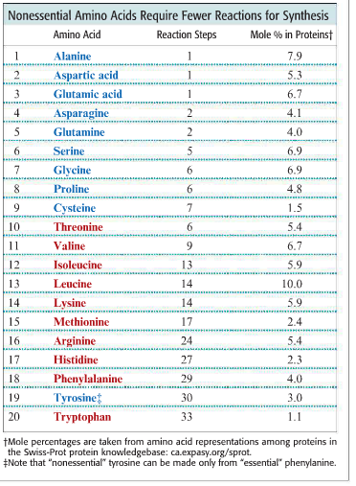
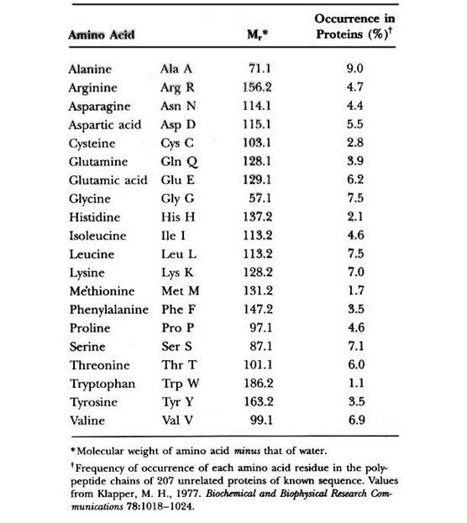
Frequency of Amino Acid Residues in Proteins
From Chap. 25,
p891 of G&G

Slide 19
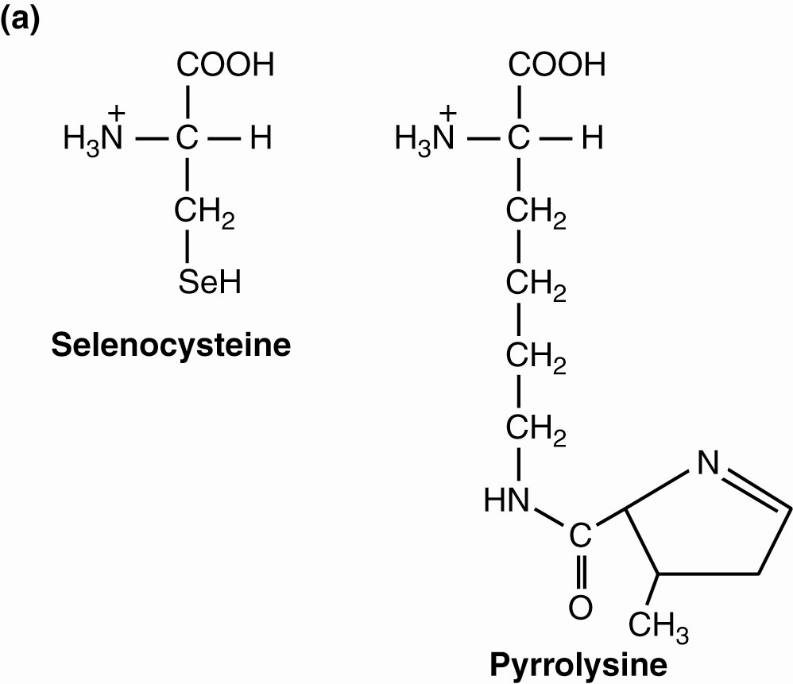
Two Additional Standard Amino Acids Occur Rarely in Proteins
Selenocysteine (Sec, U) in a few proteins in many, but not all, organisms; humans have 25 selenoproteins, plants none.
Pyrrolysine (Pyl, O) in several methanogenic archaeal species & one bacterium
Fig. 4.4

Slide 20
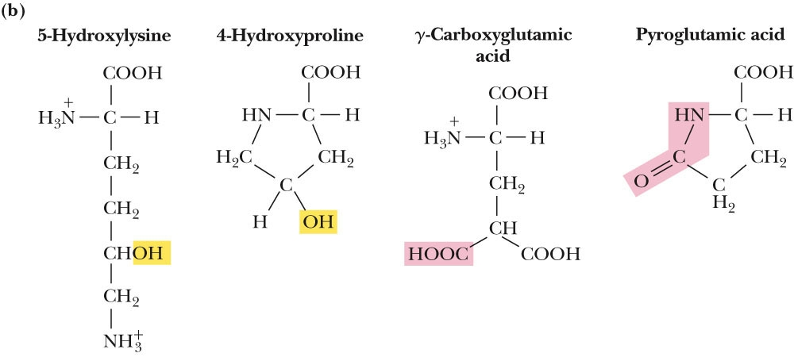
Several Post-translationally Modified Amino Acids Occur Rarely in Proteins
Figure 4.4 (b) Some amino acids are less common, but nevertheless found in certain proteins. Hydroxylysine and hydroxyproline are found in connective-tissue proteins; carboxy-glutamate is found in blood-clotting proteins; pyroglutamate is found in bacteriorhodopsin, a light-driven proton pump (see Chap. 9).

Slide 21
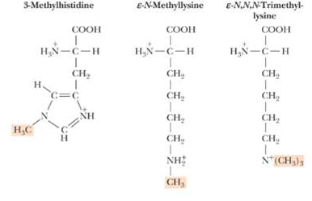
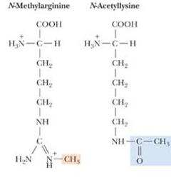
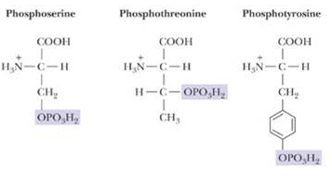
Several Post-translationally Modified Amino Acids Occur More Often in Proteins and are Usually Involved in Signaling/Regulation
You can see additional modifications in Chapter 5, Table 5.5 on page 135.

Slide 22
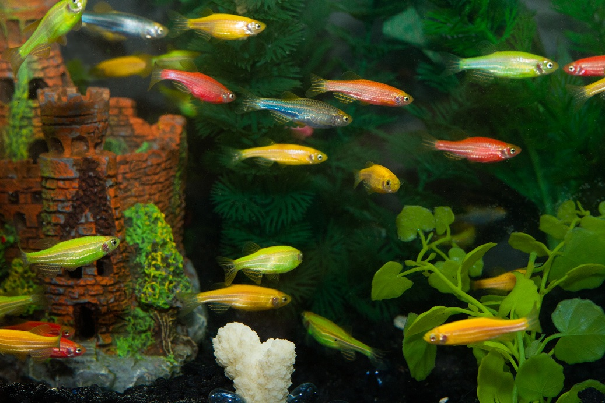
GloFish: Available only in the USA (except California)
GFP-recombinant Zebrafish

Slide 23
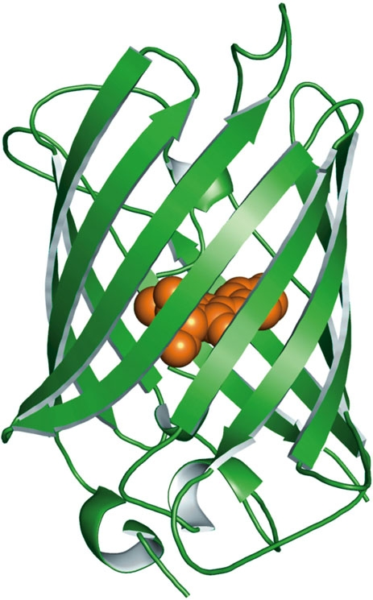
Green Fluorescent Protein: An Unusual Post-translational Auto-Modification
A jellyfish (Aequorea victoria) native to the northwest Pacific Ocean contains a green fluorescent protein. GFP is a naturally fluorescent protein. Genetic engineering techniques can be used to “tag” virtually any protein, structure, or organelle in a cell. The GFP chromophore (orange) lies in the center of a β-barrel protein structure.

Slide 24
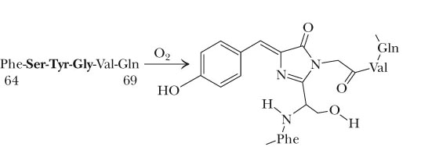
Green Fluorescent Protein Chromophore
The chromophore of GFP is an oxidative product of the sequence –FSYGVQ-.

Slide 25
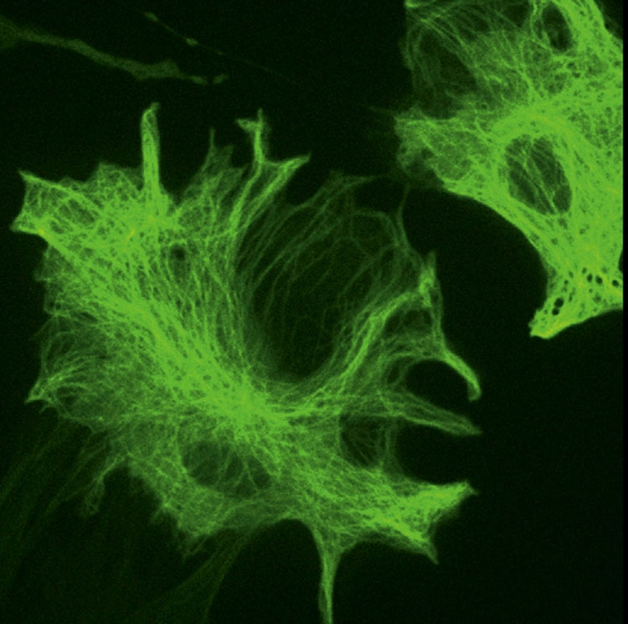
Yellow fluorescent protein
Amino acid substitutions in GFP can tune the color of emitted light. Shown here is an image of African green monkey kidney cells expressing yellow fluorescent protein (YFP) fused to α-tubulin, a cytoskeletal protein.

Slide 26
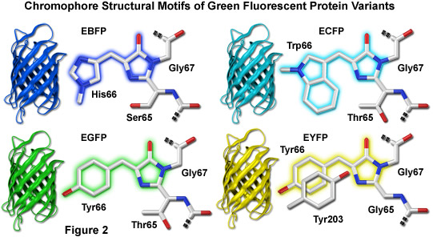

Slide 27
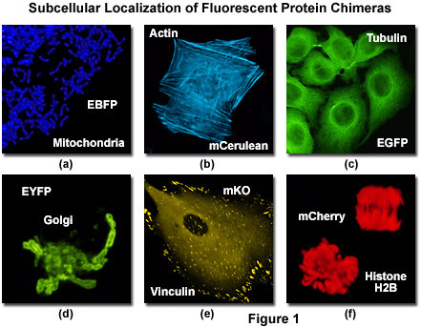
The Fluorescent Protein Color Palette
From http://www.olympusconfocal.com/applications/fpcolorpalette.html

Slide 28
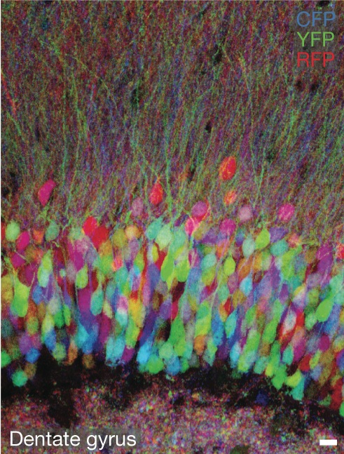
Fluorescent protein-tagging of brain neurons
Expression of combinations of three different fluorescent proteins in a mouse brain produces ten different colorations of neurons. Individual neurons in a mouse brain appear in different colors in a fluorescence microscope. This “Brainbow” method enables many distinct cells within a brain circuit to be viewed at one time. This technique may facilitate analysis of neuronal circuits on a large scale.

Slide 29
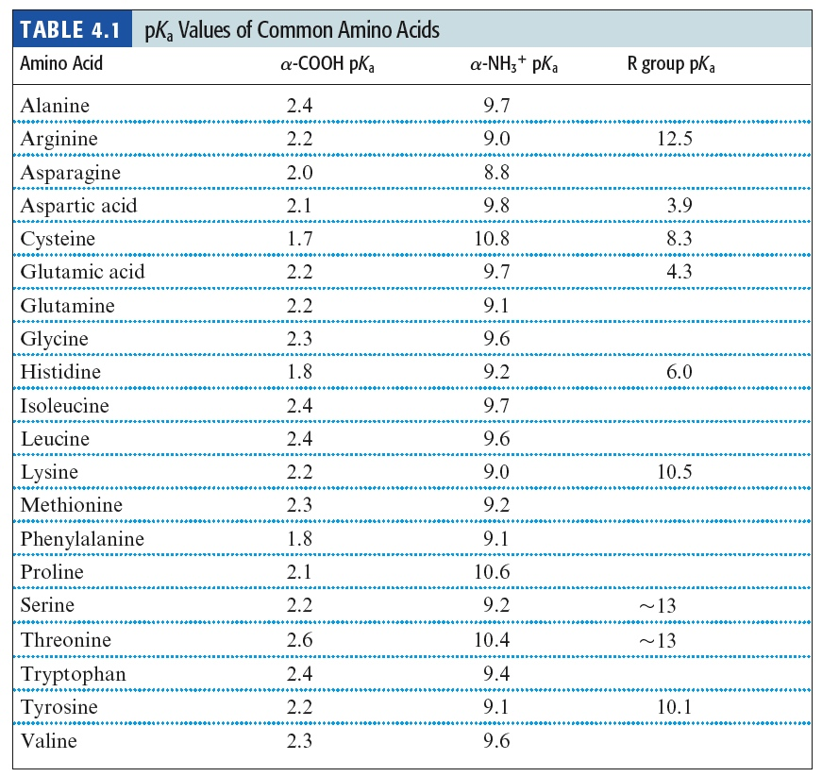

Slide 30
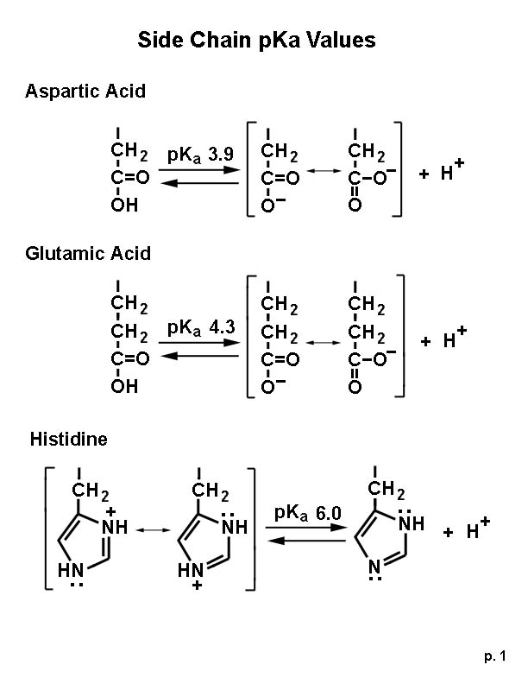

Slide 31
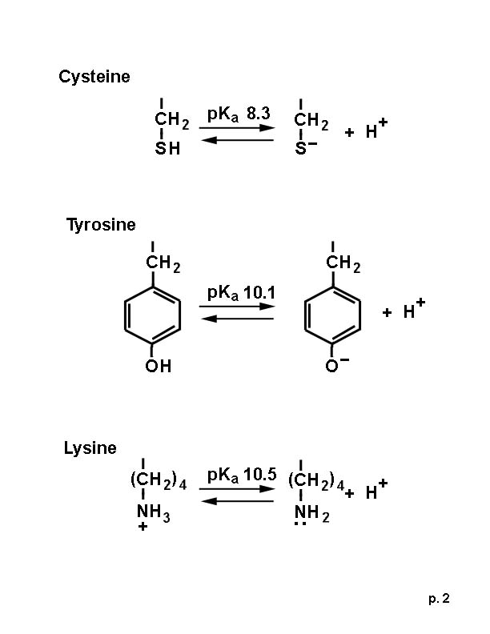

Slide 32
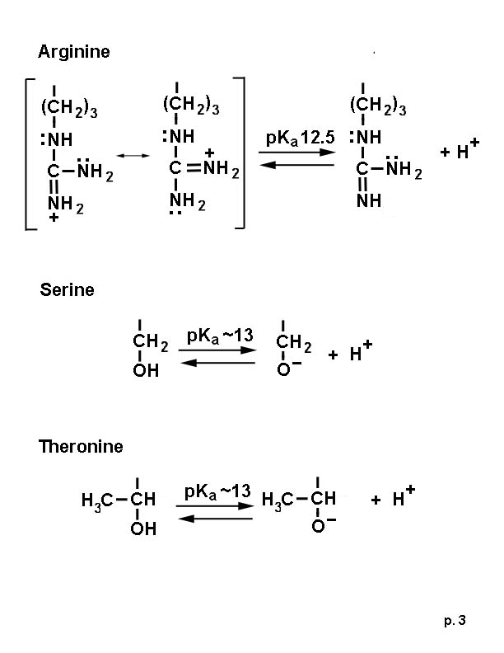

Slide 33
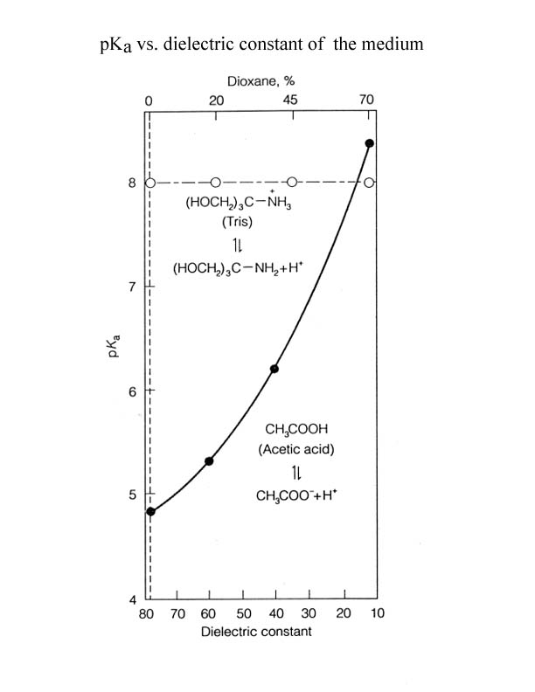
pKa values can be changed by the environment

Slide 34
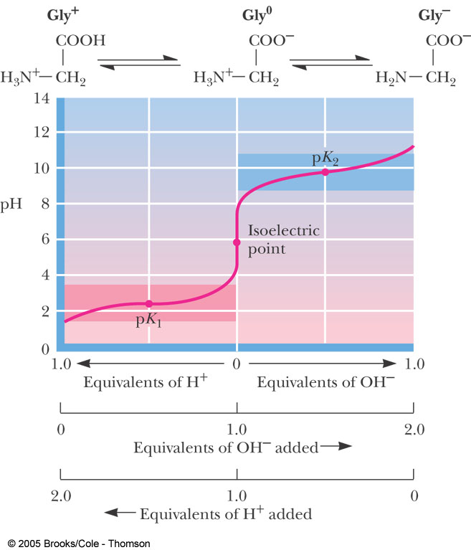
Figure 4.6 Titration of glycine, a simple amino acid. The isoelectric point, pI, the pH where the molecule has a net charge of 0, can be calculated as (pK₁+ pK₂)/2.

Slide 35
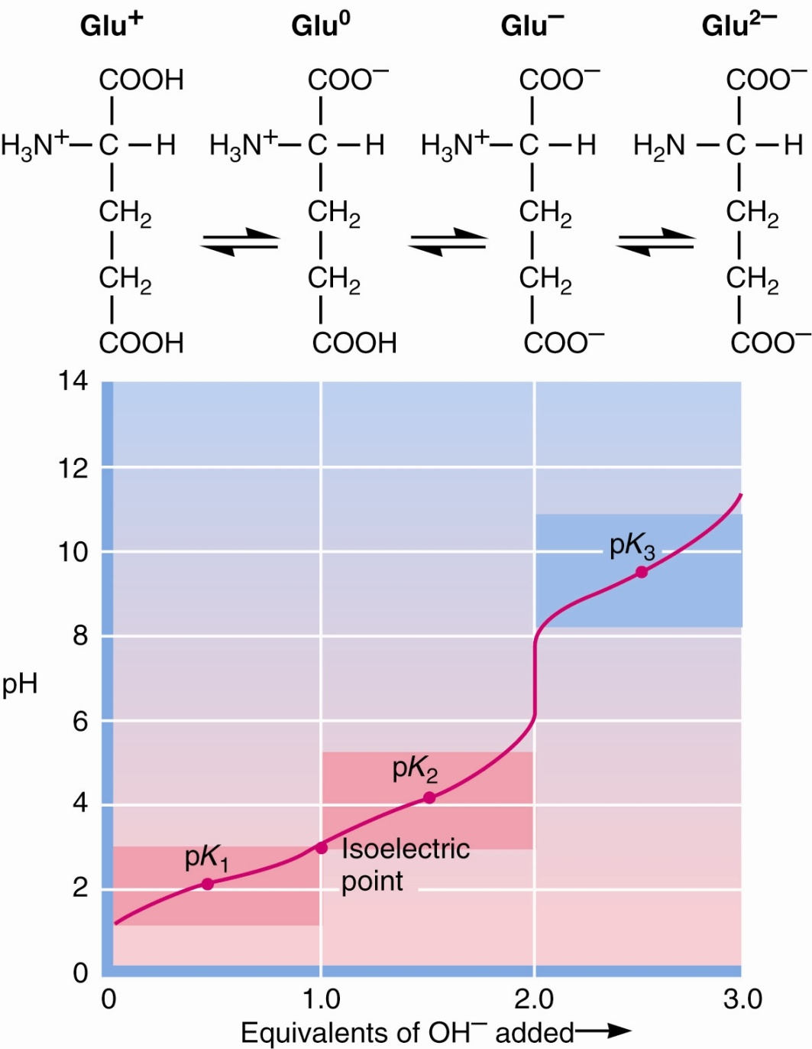
Titrations of polyprotic amino acids
Figure 4.7 Titration of glutamic acid

Slide 36
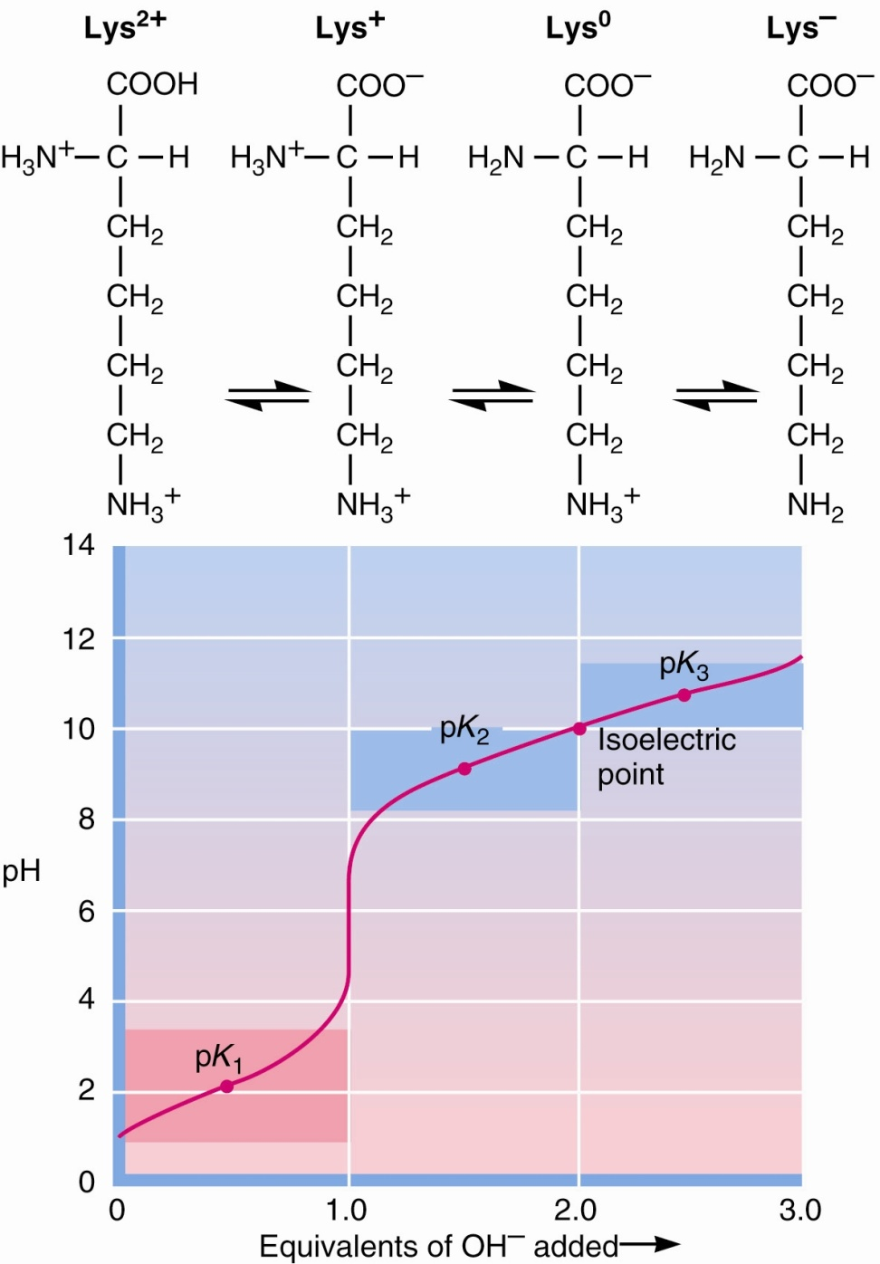
Titrations of polyprotic amino acids
Figure 4.7 Titration of lysine.

Slide 37
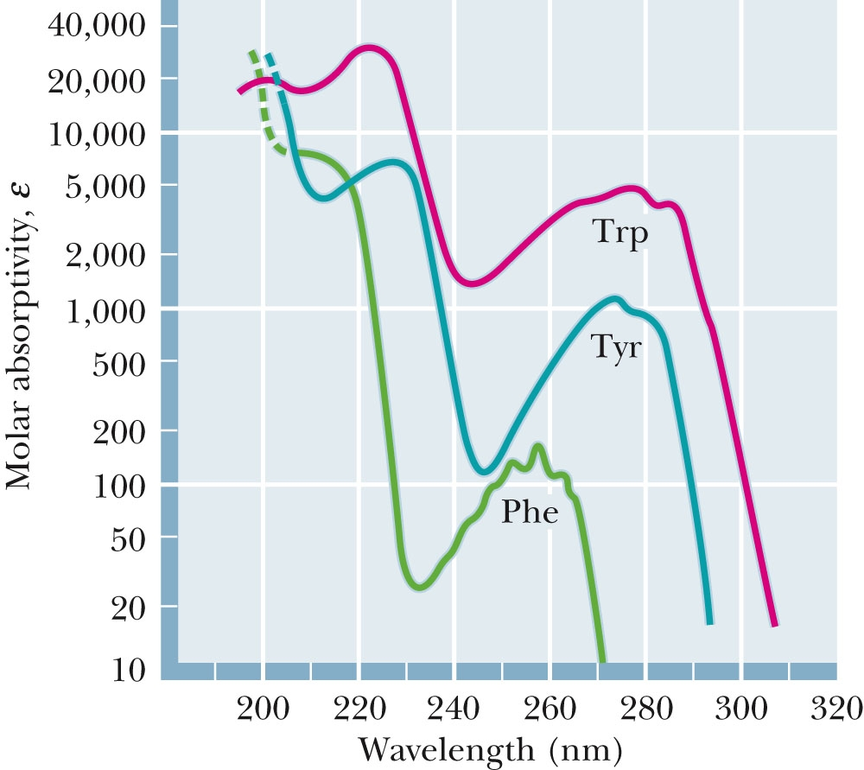
Spectroscopic Properties
Figure 4.10 The UV spectra of the aromatic amino acids at pH 6.

Slide 38
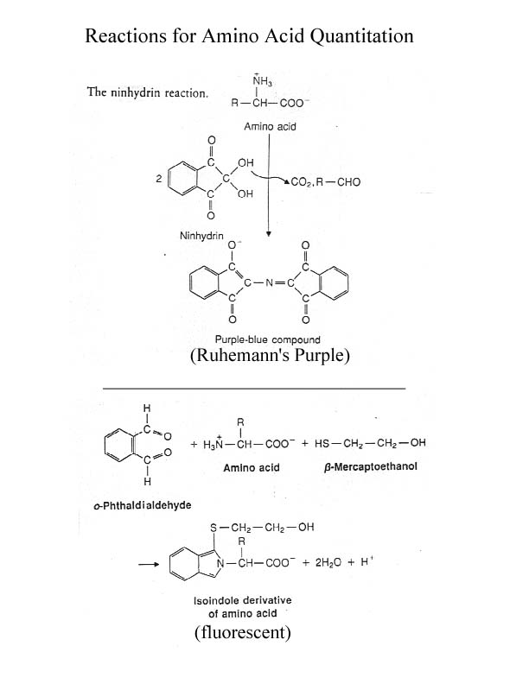

Slide 39
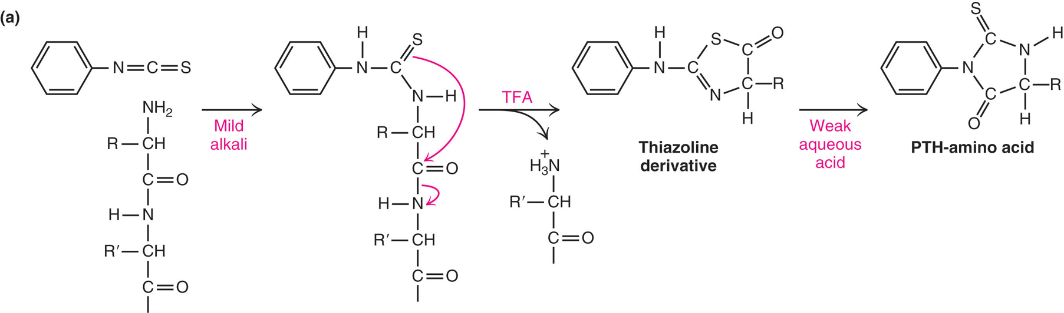
Reactions for Amino Acid Quantitation
Fig. 4.8 (a) Edman reagent, phenylisothiocyanate, reacts with the α-amino group of an amino acid or peptide to produce a phenylthiohydantoin (PTH) derivative, that can be detected by uv asorbance at 254 nm.

Slide 40
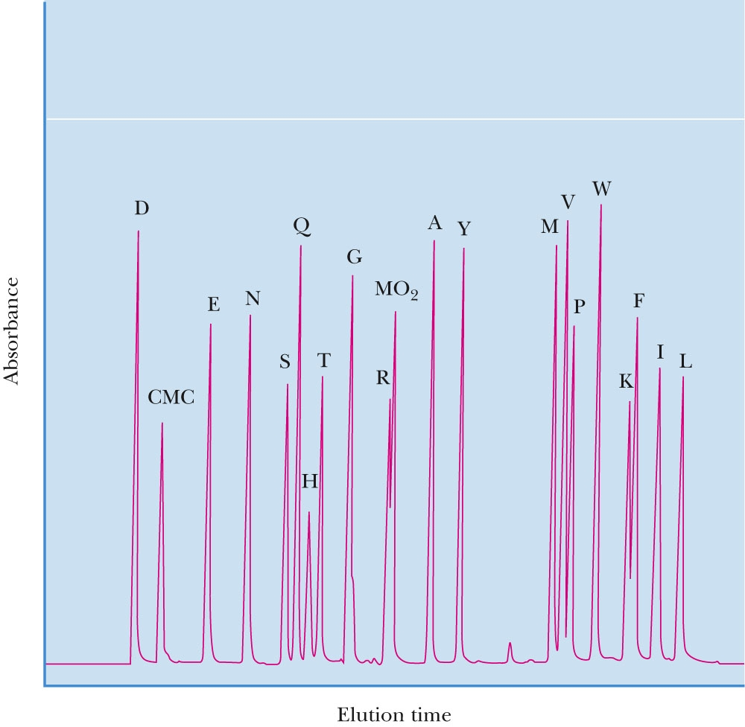
Separation of Amino Acids for Quantitation
Figure 4.13 Gradient separation of common PTH-amino acids by HPLC
(High Performance/ Pressure Liquid Chromatography). Areas under peaks are proportional to the moles of each amino acid.

Slide 41
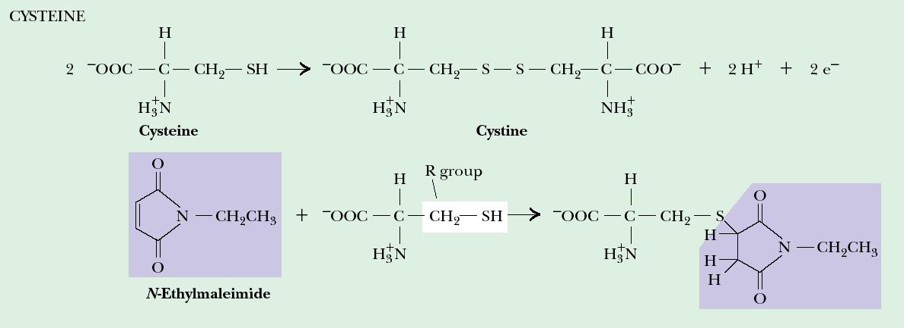
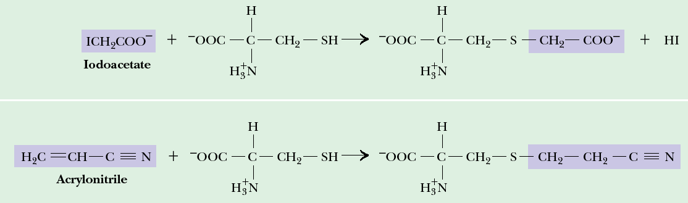
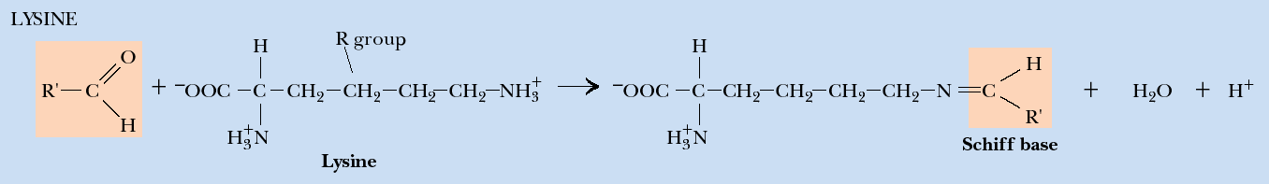
Some Reactions of Amino Acid Side Chains
Notes:
Reactions of amino acid side-chain functional groups.

